Slide 1
Linear Combination and Span
NAZMUL KADER CHOWDURY

Slide 2
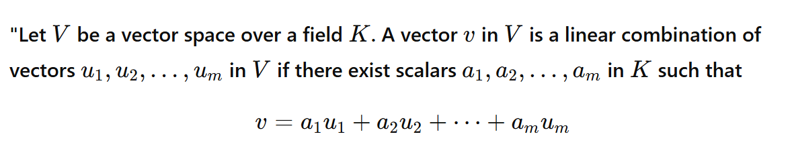

Slide 3
















What is Linear Combination?
5$×$
$$+$$
7$×$
$$=$$
$$=$$
6$×$
+ 4$×$
$$=$$
+ 7$×$

Slide 4
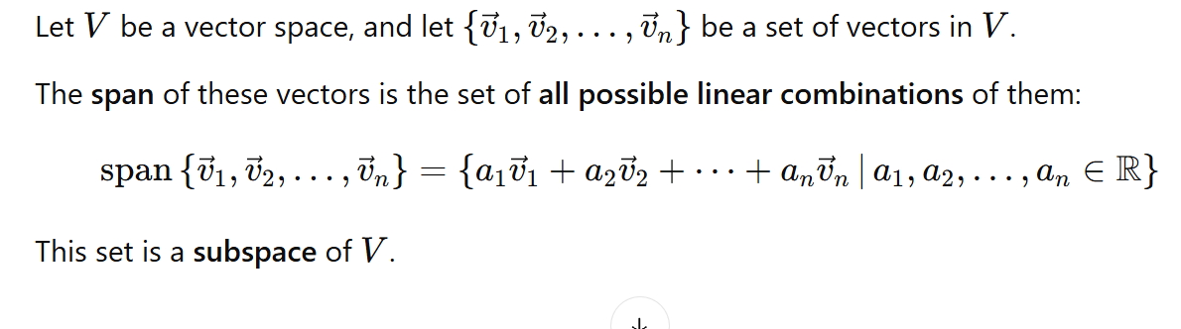
What is Span?

Slide 5
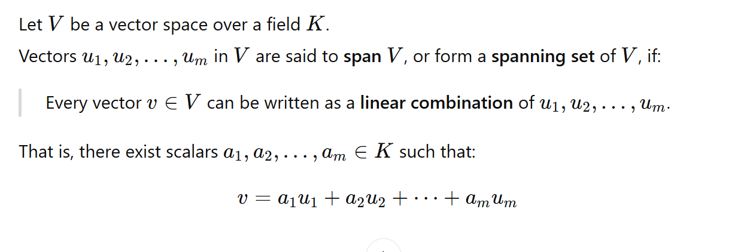
What is Spanning set?

Slide 6



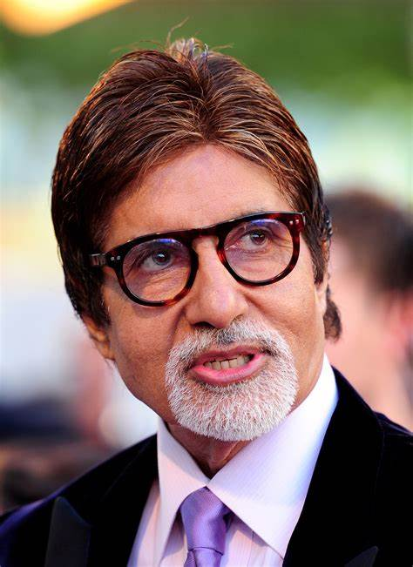

100$×$
+100
+100
+10
=
10+
10
+10
+10
=

Slide 7
Span= {
}
Spanning
Set= {
}

Slide 8







Slide 9

Span= {
}
Spanning
Set= {
}

